Slide 1
The first Hungarian one-stop-shop Learnings from the RenoPont Energy Home Renovation Centres
Zsuzsanna KORITÁR
http://mehi.hu
http://renohub-h2020.eu
This project has received funding from the European Union’s Horizon 2020 research and innovation programme under grant agreement No 845652.

Slide 2
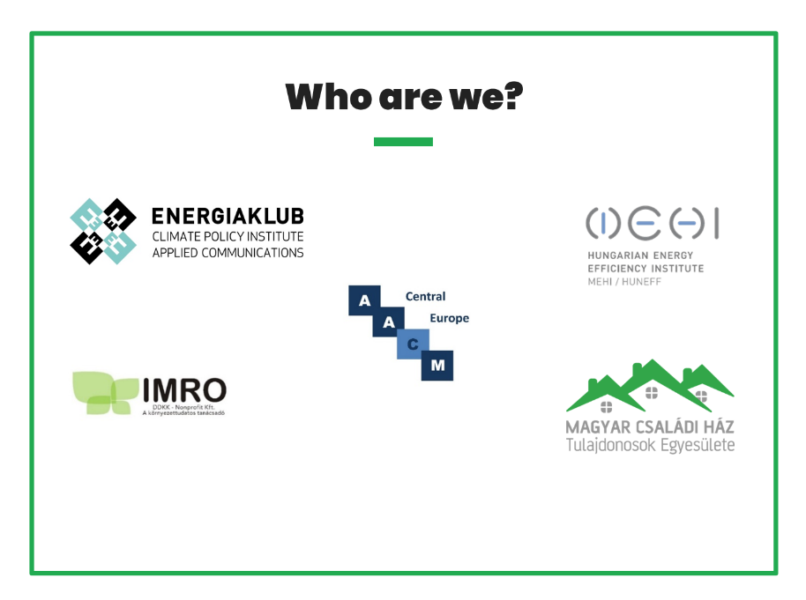
The RenoHUb project
• Horizon 2020 project consisting exclusively of Hungarian consortium members (5 partners)
• 3 years long (November 2019 - November 2022) – with a possible prolongation until May 2023

Slide 3
Developing the RenoHUb model
Aim: to define the RenoHUb customer journey and elaborate services offered by OSS
Target groups: single-family and multi-apartment residential buldings
Background research:
Database about good practices: desktop research of 33 OSS projects
Focus group research on homeowners motivations, drivers and obstacles, as well as pre-researching the one-stop-shop concept → physical offices are needed
Deep interviews with main stakeholders, market players

Slide 4
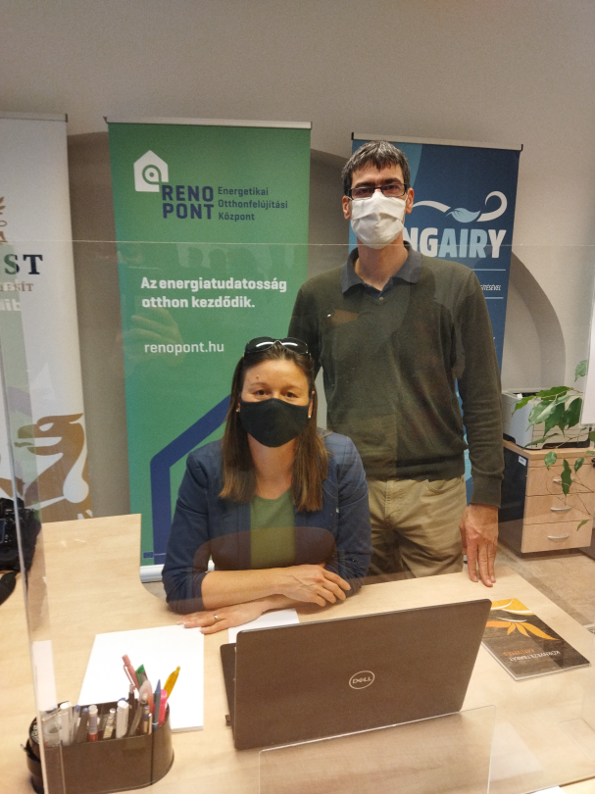
The Hungarian brand

Slide 5
Two pillars of the RenoPont OSS
The Online Platform
The Information Hotspots (Offices)

Slide 6
The Online Platform https://renopont.hu/
EDUCATE, INFORM
EXPERT DATABASE
RESOURCES
VISIT OUR OFFICES

Slide 7
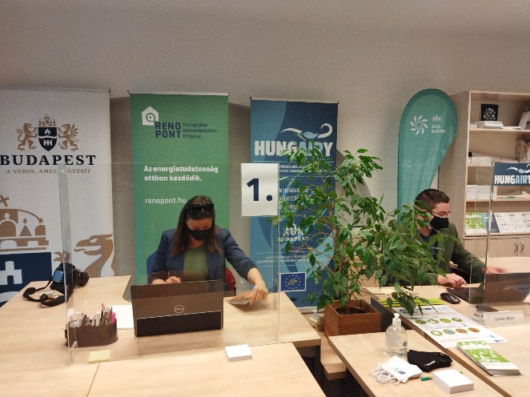
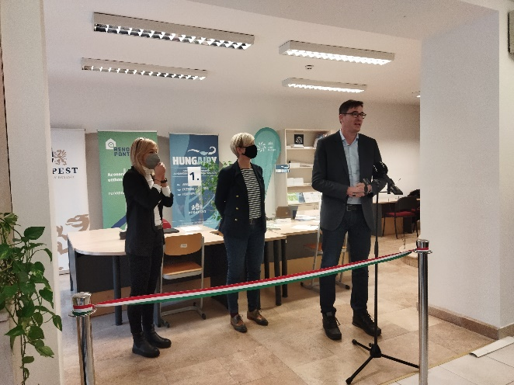
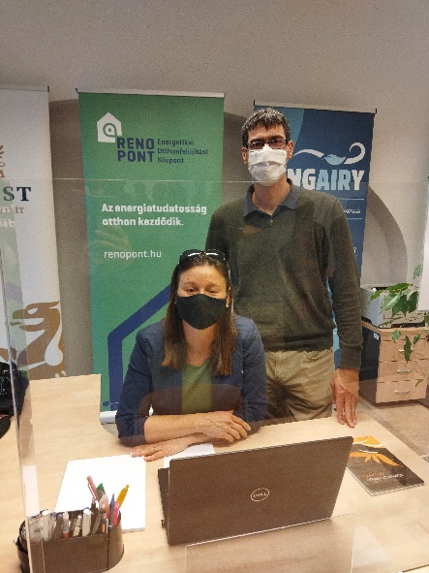
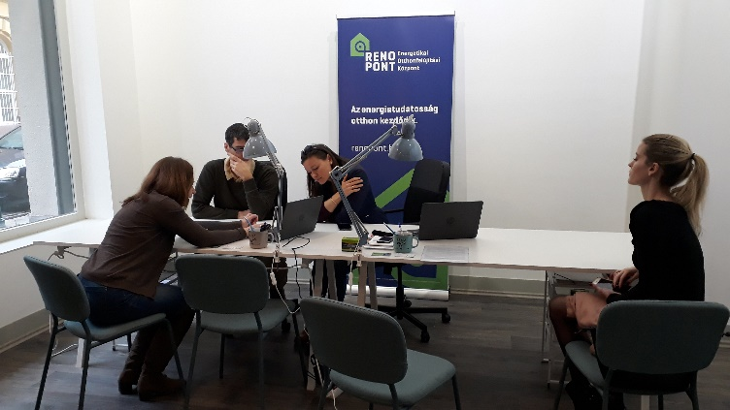
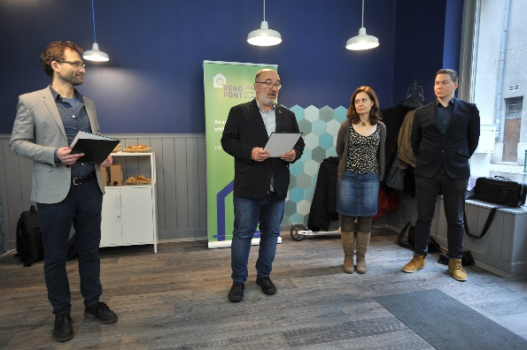
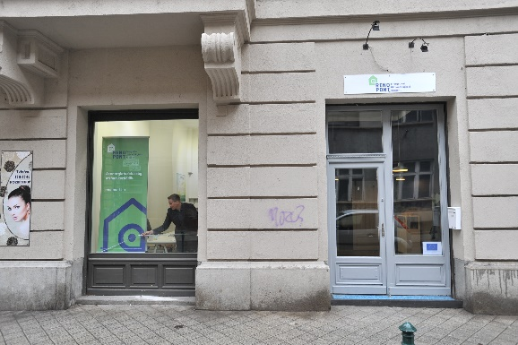
RenoPont offices

Slide 8
Operation of RenoPont offices
SERVICES:
Certified and contracted energy assessors
Energy Renovation Concept with options and preliminary cost estimation
Guidance to customer on possible financing options
Assistance on selecting between price offers
EXPERIENCE:
Reserved appointments
Prepared customers
Specific questions
Financing as an issue comes up in almost every visit

Slide 9
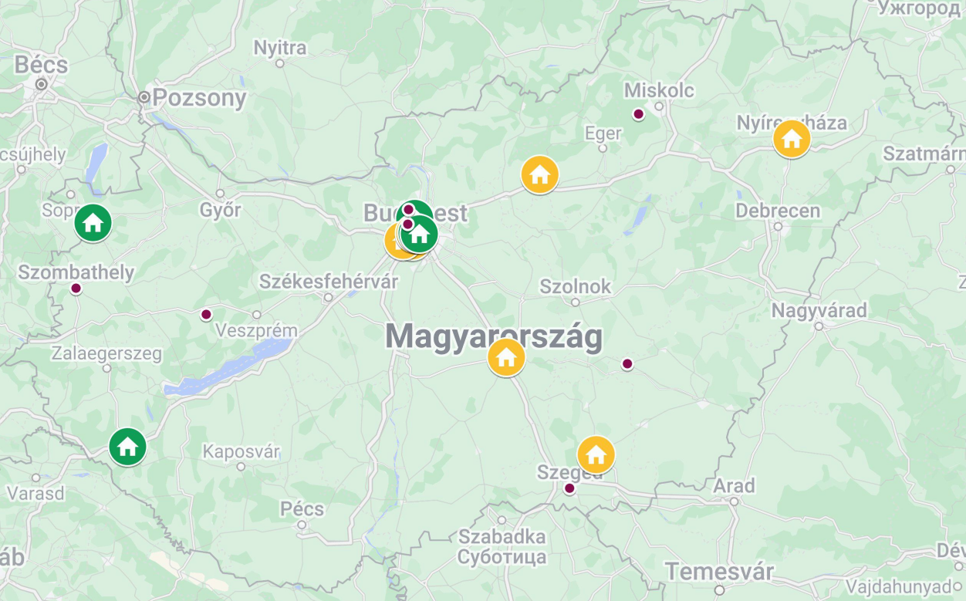
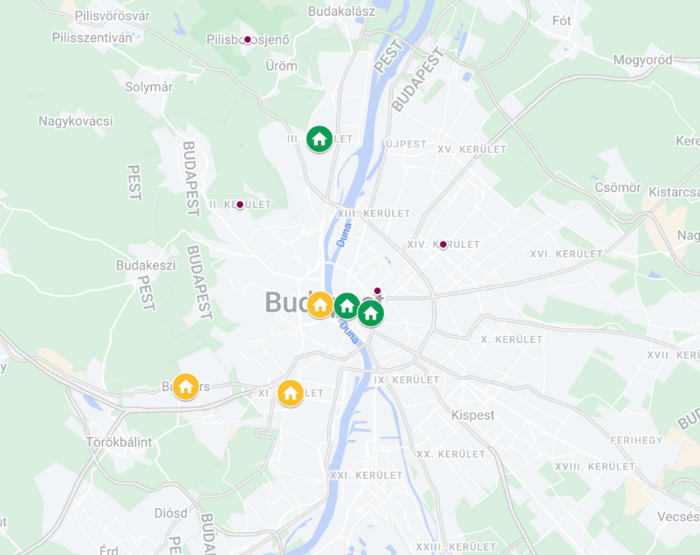
RenoPont offices
Operating RenoPont offices
Potential RenoPont offices (ongoing negotiations)
Interested municipalities

Slide 10
Sustainability and scaling up by cooperations
FINANCIAL INSTITUTIONS
MUNICIPALITIES
INSTALLERS, ENERGY AUDITORS
REAL ESTATE AGENCIES
MANUFACTURERS
UTILITES (EEOS – OBLIGATED PARTIES)

Slide 11
Thank you!
Zsuzsanna Koritár
MEHI Hungarian Energy Efficiency Institute
http://mehi.hu
http://renohub-h2020.eu
This project has received funding from the European Union’s Horizon 2020 research and innovation programme under grant agreement No 845652.

