Slide 1
One-Stop-Shop Model For Triggering Home Energy Renovation In Hungary
Ilona Illésné-Szécsi
Hungarian Energy Efficiency Institute (MEHI)
2023. 05. 25, C4E Forum

Slide 2
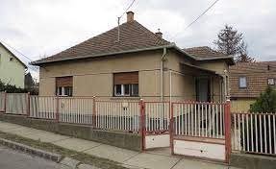
Background
Energetically outdated building stock with high energy consumption (average: 250 kWh/m2/a)
Huge potential for energy savings
Willingness to renovate (36% of population plans to renovate within the next 5 years*)
VS.
Very low (< 0,4%/year) deep renovation rate
*MEHI survey, November 2020

Slide 3
Motivations: short-term gains!
AESTHETICS AND SENSE OF COMFORT
ENERGY EFFICIENCY = SAVINGS
PRESSURE TO RENOVATE
Warm, cozy, modern apartment nicely done. Aesthetics always a primary motivation.
Immadiate drop in utility costs, expected long-term investment with payback (increased property value).
Outdated, dangerous, unreliable, broken-down appliances, moldy walls etc.
FINANCIAL BOOST
CONTROL, SAFETY AND HEALTH
BEING „GREEN”
Tenders, savings, a legacy available
More reliable, controllable equipments, no more CO hazard, draught and mold, no asthma.
Not a strong driver yet.
Notes:
Immediate, short-term gains - even though energy efficiency is primarily a rational motivator, emotional criteria (comfort and aesthetics) are extremely important
Increasing energy efficiency is embedded into the broader motivational space of the renovation: even though it is a long-term play, which makes it hard to make the commitment, it also brings immediate gratification in terms of comfort and aesthetics
Sense of comfort
More pleasant, better-functioning apartment (evenly warm in the winter / stays cool longer in the summer, fixing draught - huzat)
More modern, up-to-date solutions and appliances (smart solutions)
Aesthetic needs
Always important regardless of the renovation type, often the primary motivation offering ‘immediate’ gain
The motivating role of your own social and living environment (nicely done renovations)
Energy efficiency:
Immediate drop in utility costs (high heating costs, shocking heat map), the needs to keep the heat in
About a 10-year return on investment is expected
Increasing the value of the property
Among young people: the family grows they want to move on
Older people (as their legacy)
Higher rent can be collected if you buy the property as investment
Odd-one-out: Pressure to renovate (representative survey conducted in 2020 by MEHI),
e.g. outdated, dangerous, unreliable, broken-down appliances, windows not closing properly, moldy walls etc.
in families with small children this is a particularly important motivator (sense of danger)
Green criteria
It crops up, but it is not a strong driver yet: the primary reason for the renovation is mainly ‘selfish’ reasons, individual (and highly material) reasons are behind it
In the long term: becoming independent from service providers, being self-reliant (dethatched houses)
An important, additional emotional factor, which reinforces their motivations, if the other needs are met

Slide 4
Property value research How much more is your house worth if you energetically upgrade it?

Slide 5
Barriers: lack of information and money
GENERAL FEAR OF THE PROCESS
LOT OF DOUBTS, UNKNOWN ADVANTAGES
DIFFICULT OR NO SUBSIDIES
UNPREDICTABILITY AND LACK OF CONTROL
LACK OF EXPERIENCE AND EXPERTISE
LACK OF TRUST AND LACK OF INSTALLERS
Notes:
Huge investment!!
The greatest obstacles to energy efficiency improvement projects are primarily the result of a lack of information and of financial constraints (high labor costs and a long return on investment).
Doubts about recouping the investment
Access to subsidized funding
A lack of information
Application process for subsidized funding is bureaucratic
Additional fees attached to supposedly free funding
Makes timing difficult
Hard to plan the timing
Seasonality, family life
Especially if you stay in your home during the renovation (a lot of hassle, dirt and stress)
Budgeting problems
Growing material and labor costs
Fear of unexpected, unforeseen expenses
E.g. installing the chimney lining is usually unexpected
A basic lack of trust
Uncertainty resulting from a lack of information and expertise → feeling helpless
Preconception (about the bureaucracy and the reliability of the contractors), a lack of first-hand experience

Slide 6
Solution: the first Hungarian one-stop-shop energy home renovation system
Providing customers with the technical, financial and legal information and services they need in one place
Guides the client through the whole renovation process
Helps to increase the quantity and quality of domestic deep energy renovations

Slide 7
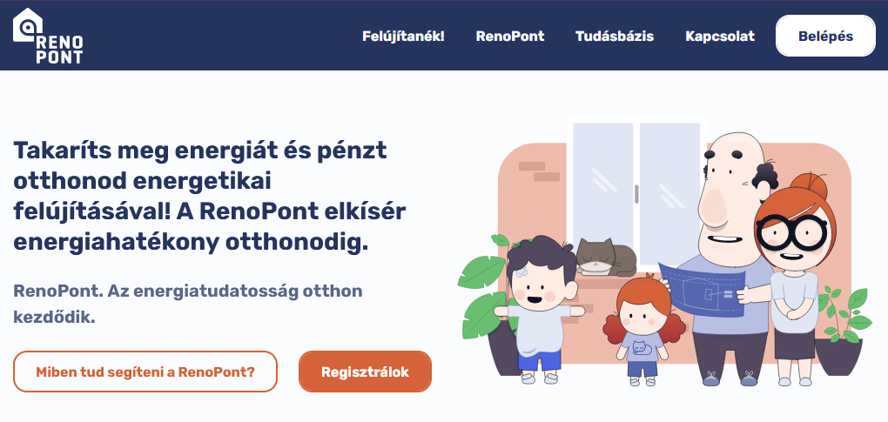
RenoPont One-Stop-Shop Energy Home Renovation Centre
RenoPont website (renopont.hu)
RenoPont Hotspots/Offices
Start: 17. November 2021.
Nagykanizsa, Budapest City,
Budapest Józsefváros, Budapest Óbuda, Sopronkövesd, Budapest Budavár

Slide 8
Services available on the RenoPont website Technical, financial and legal information
Benefits of deep renovation
Best practices
Product selection guide
Support and financing options
Template documents (sample contracts, tender documents)
Glossary and F.A.Q.
Office appointments and online consultation
Energy saving calculator
Specialist and contractor database, with qualified and assessable professionals
Notes:
Specialist database – our competitor doesn’t suggest specialists and contractors; so our service energy efficiency consultancy + suggesting qualified specialists is unique

Slide 9
Energy saving calculator
Inputs: basic data of building (construction period, wall, insulation, door and window, heating system)
Results:
Primary energy demand
Energy rating (estimated)
Condition of different structures
Energy saving potential of different renovation measures

Slide 10
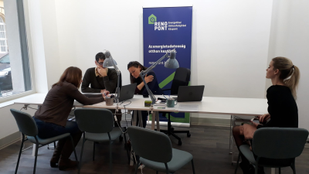
Types of offices
1. Municipal maintenance, municipal staff
2. Municipal maintenance, external energy auditor
3. Office maintained by an entrepreneur
4. MEHI office

Slide 11
Energy crises and current policy landscape
Significant growth in energy prices (from July 2022) mainly in single family houses
No home renovation subsidies
Very high interest rate (11-13%)
One-off technical consultancy by Hungarian Chamber of Engineers supported by state
No EU-fund, state or municipal support for RenoPont

Slide 12
(Financial) Sustainability of RenoPont
1. Maintaining the current network and services
2. EU-Peers tender: sharing knowledge on OSS with 10 countries
3. Developing RenoPont services – energy audit, renovation plan, tender writing
4. Developing joint services with banks, real estate agents, product manufacturers
5. Energy efficiency trainings for companies, municipalities
6. Attracting EEOS resources
7. Sponsorship of MEHI partners and other product manufacturers
8. Opening new offices, mainly in rural areas (single-family houses)
9. Possibility of cooperation with existing initiatives (energy providers, energy consultants) and lobbying for public support

Slide 13
Potential revenues
1. Paid services for renovators: energy audit, renovation plan, tender writing
2. Commission fee from specialists, contractors
3. Commission fee from energy specialists and energy auditors who certify saving from multi-apartment building renovations in the EEOS
3. Franchise fees from offices maintained by an entrepreneuer
4. Commission fee from banks: technical advice to support a renovation loan
5. Commission fee from product manufacturers for product catalogue and sponsorship (Betterhome)
6. Revenues from energy efficiency trainings
7. EEOS financing for awareness-raising activities

Slide 14
Thank you for your attention!
Ilona Illésné-Szécsi
Hungarian Energy Efficiency Institute
szecsi@mehi.hu
www.mehi.hu
www.renohub-h2020.eu
www.renopont.hu

